Slide 1


Data Engineering
LTAT.02.007
Prof.Ahmed Awad
Ass Prof. Riccardo Tommasini
Kristo Raun, Mohamed Ragab
Graph Databases (Neo4j)

Slide 2

Whoami?
PhD Student, and researcher at DSG, Tartu University, Estonia.
Data and Graphs Big Fan.
Former Lecturer Assistant.
(Big) Data Analyst.
Apache-Spark, Hive, HDFS,...and others.
Research Interests: Semantic Web, Big Data, AI (recently).
https://scholar.google.com/citations?user=DFVt7CYAAAAJ&hl=en

Slide 3

Agenda
Relational vs. graph databases
Which to use and when?
From Relational to Graph
What is Neo4j?
The Property Graph Model (PGM)
Cypher Query Language
Cypher In Action
MovieGraph Dataset in neo4j
Cypher Query Clauses and Examples

Slide 4
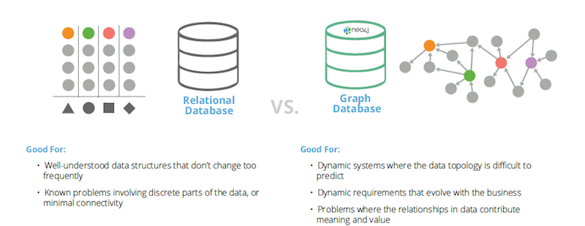
Relational vs. graph databases
https://neo4j.com/news/relational-vs-graph-databases/

Slide 5
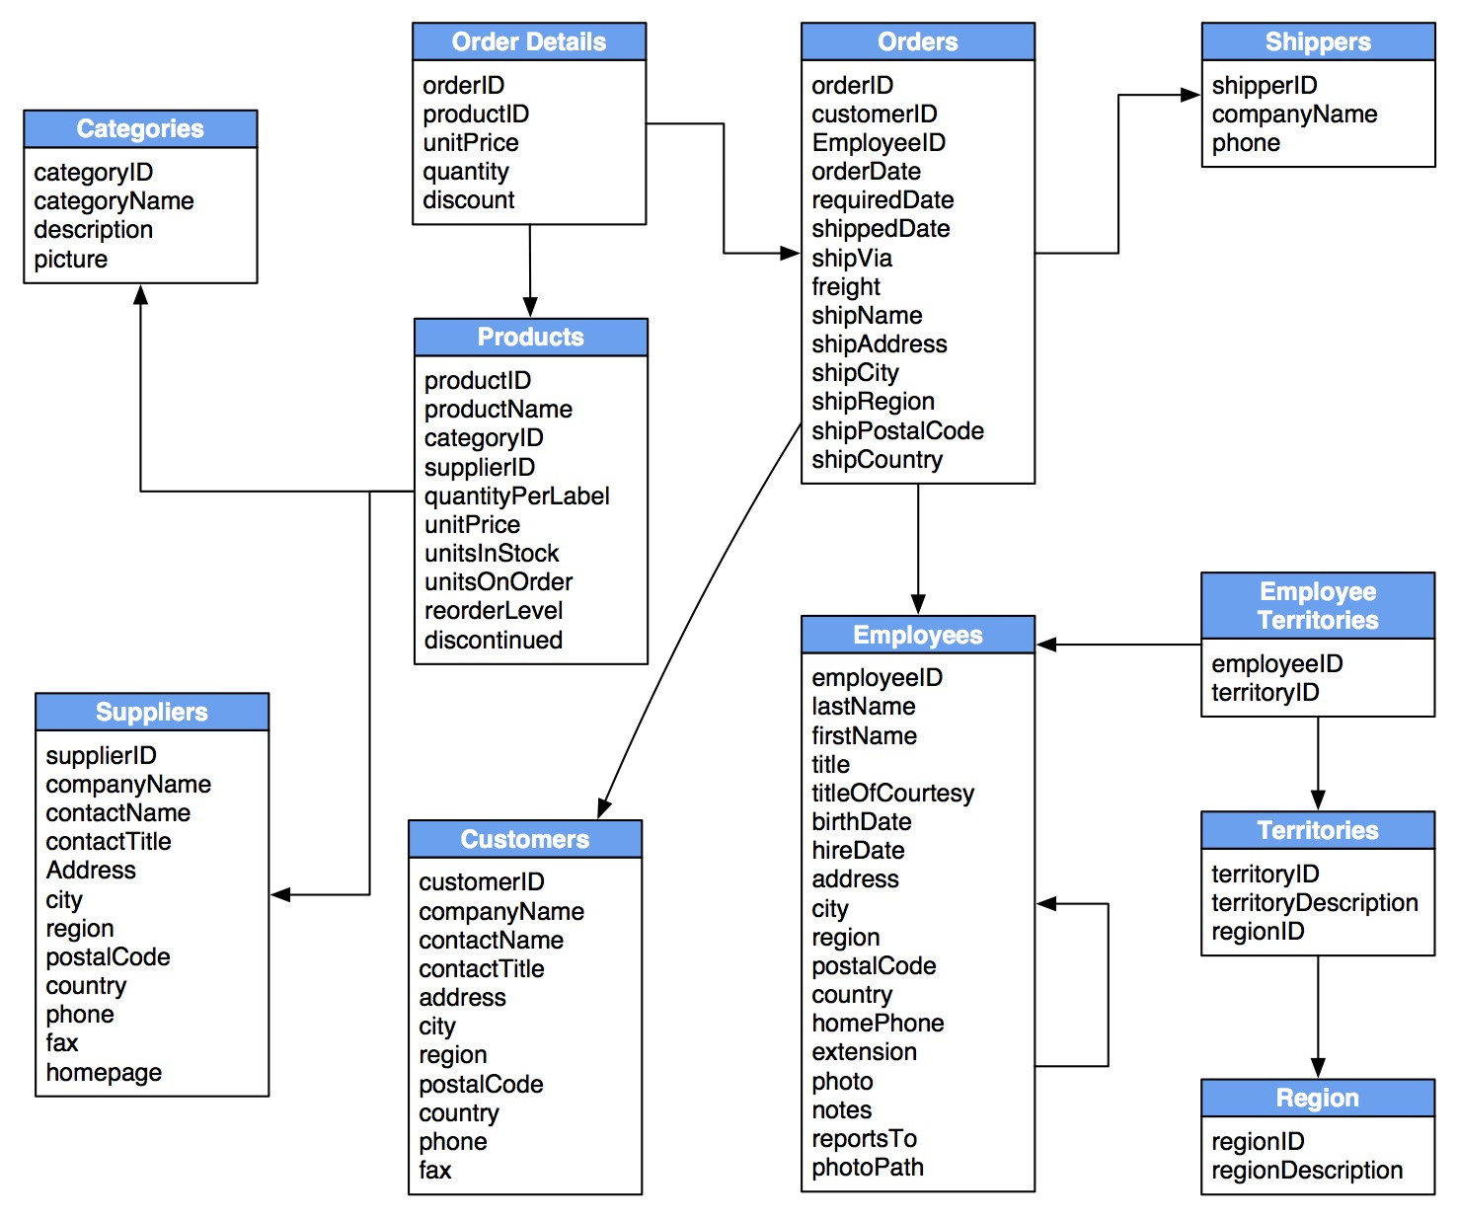
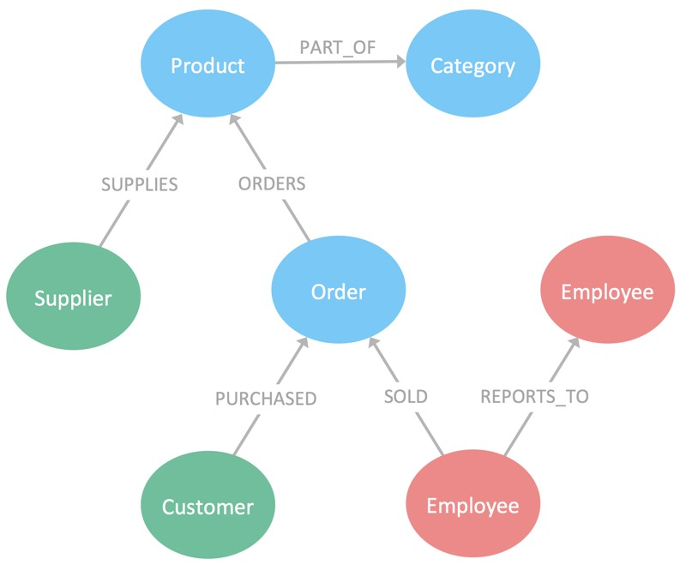
From Relational to Graph
https://neo4j.com/business-edge/relational-to-relationships/

Slide 6
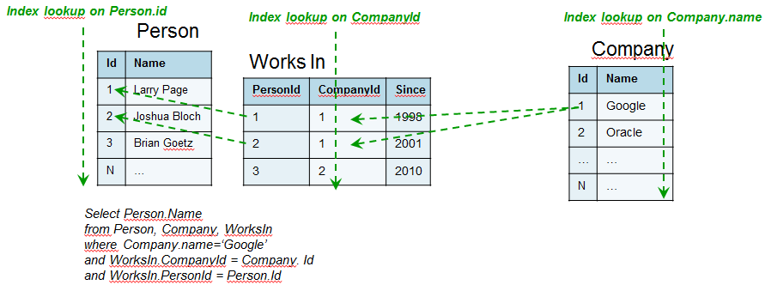
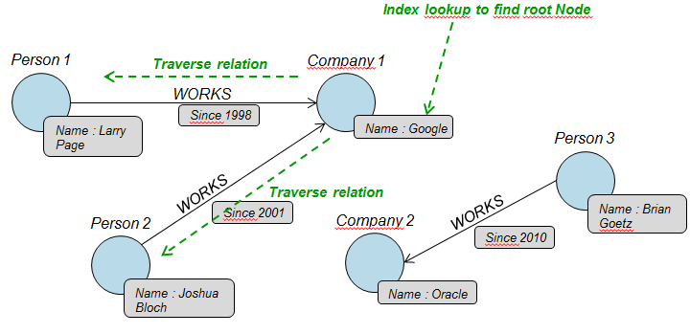
From Relational to Graph
https://blog.octo.com/en/graph-databases-an-overview/

Slide 7






Graph Databases
https://www.g2.com/categories/graph-databases

Slide 8
Neo4j
A graph database management system developed by Neo4j, Inc.
Supports ACID (Atomicity, Consistency, Isolation, Durability) properties.
It implements a Property Graph Model to store the data.
Its implementation in Java also makes it widely usable, you still can access it using other languages using available drivers.
It uses Cypher as a declarative query language.

Slide 9
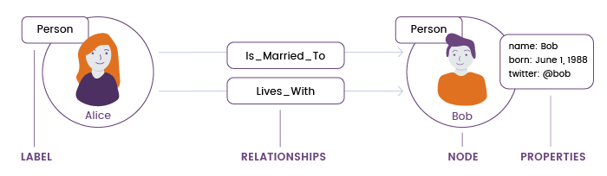
Property Graph Model
https://www.slideshare.net/lvca/how-graph-databases-started-the-multi-model-revolution

Slide 10
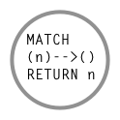
What is Cypher?
Graph Query Language for Neo4j, and other GDBs.
Aims to make graph querying simple.
Cypher is Declarative QL
specify starting point specify desired outcome
algorithm adaptable based on query
Based on graph Pattern matching (ASCII-art patterns).
Cypher is Familiar for SQL users.

Slide 11
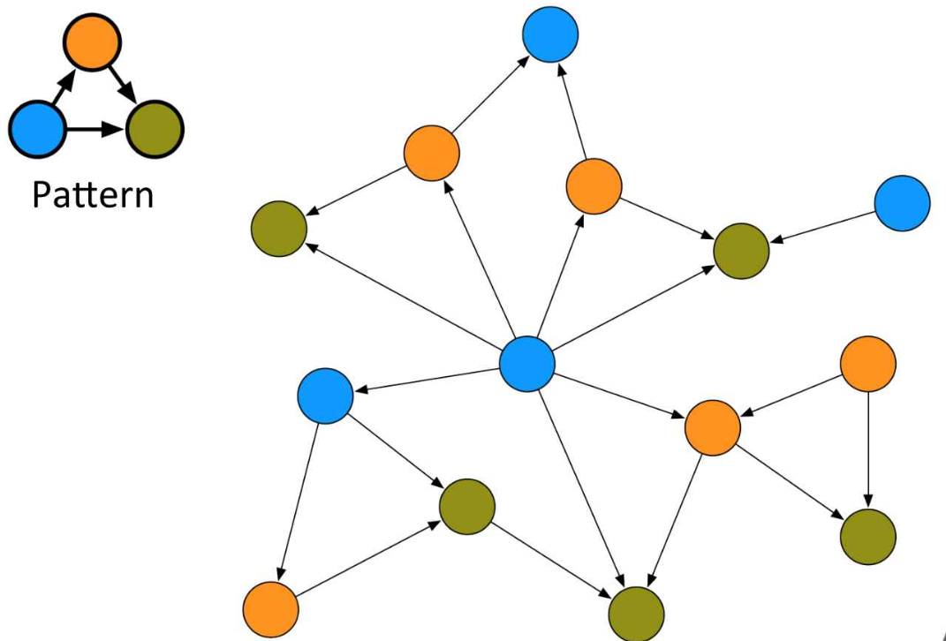
Pattern Matching
Queries in form of graph pattern
https://www.infoq.com/presentations/Complex-Data-graph-Neo4j/

Slide 12
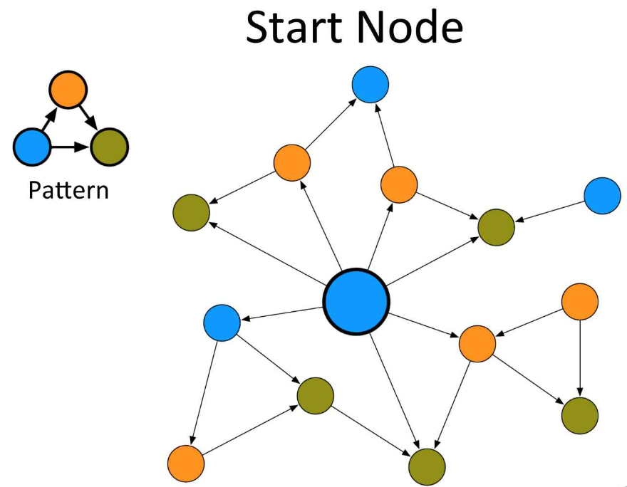
Pattern Matching
Select at least Start Node

Slide 13
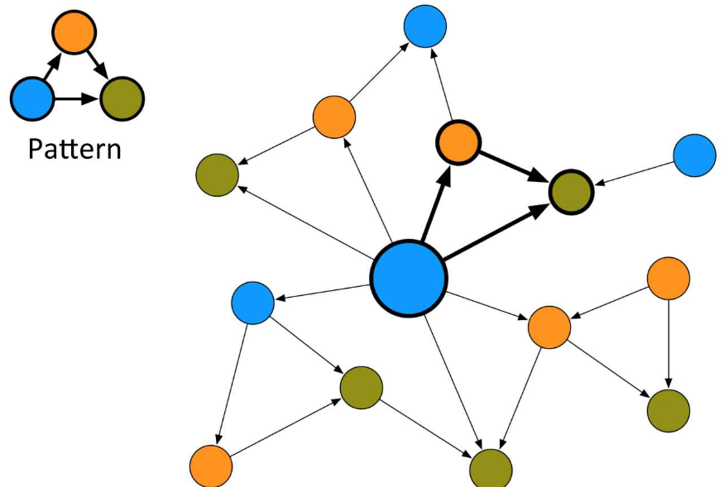
Pattern Matching
Our first Match

Slide 14
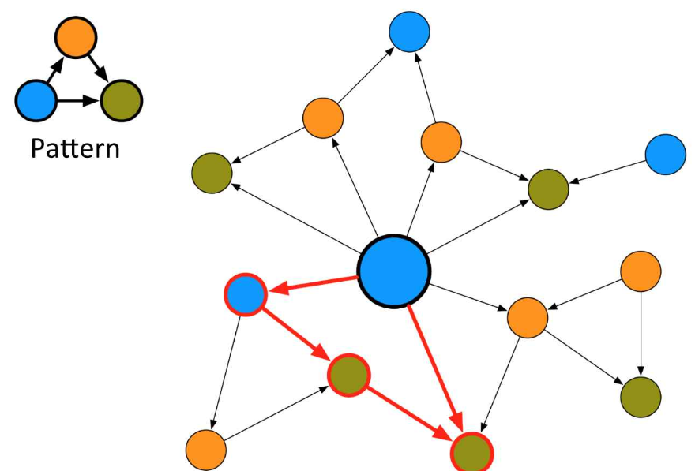
Pattern Matching
This is not match!

Slide 15
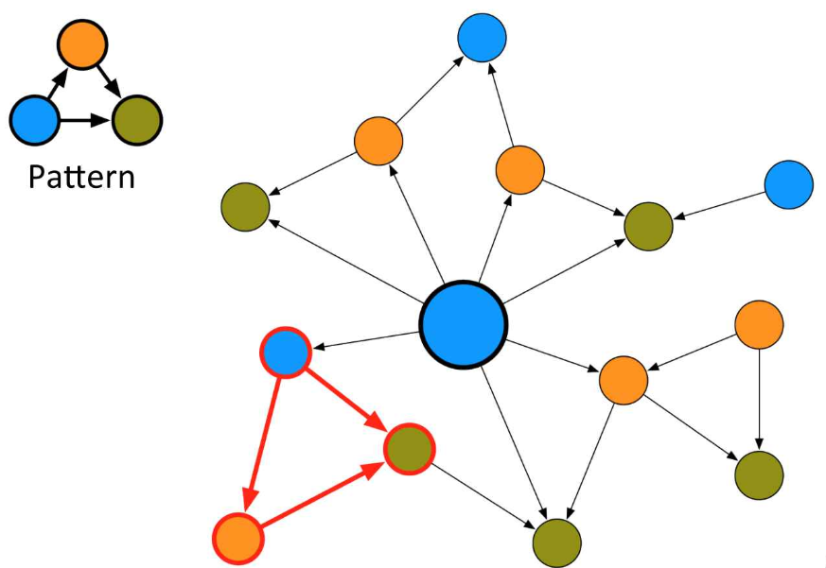
Pattern Matching
This is also non-Match.
Why?!

Slide 16
ASCII-art patterns
Directed relationship
(A) -->(B)
A
B

Slide 17
ASCII-art patterns
Undirected relationship
(A)--(B)
A
B

Slide 18
ASCII-art patterns
Specified relationship
Loves
(A) –[:Loves]->(B)
A
B

Slide 19
ASCII-art patterns
Joined Paths
(A) –->(B) --> (c)
A
B
C

Slide 20
ASCII-art patterns
multiple Paths
>> (A) –->(B) --> (c), (A) --> (c)
>> (A) –->(B) --> (c) <-- (A)
A
B
C

Slide 21

Cypher In Action
https://s3.amazonaws.com/images.seroundtable.com/google-hands-dirty-1436184854.jpg

Slide 22
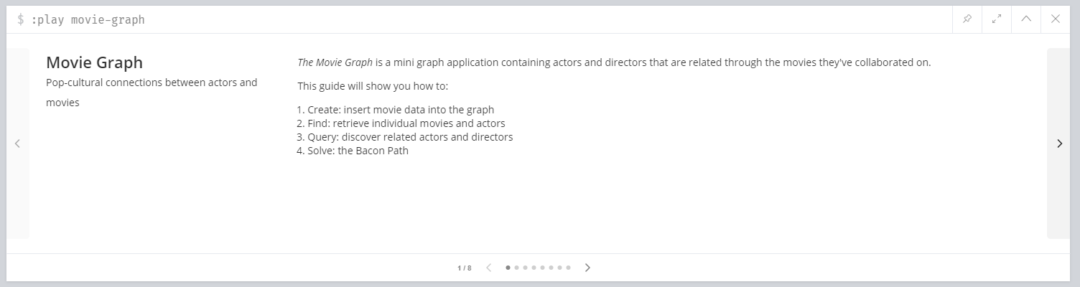
Movie Dataset Example
Excerpt of actors, directors, producers,, etc and related movies.
Available on your installed Neo4j versions.
In your neo4j browser run:
:play movie-graph

Slide 23
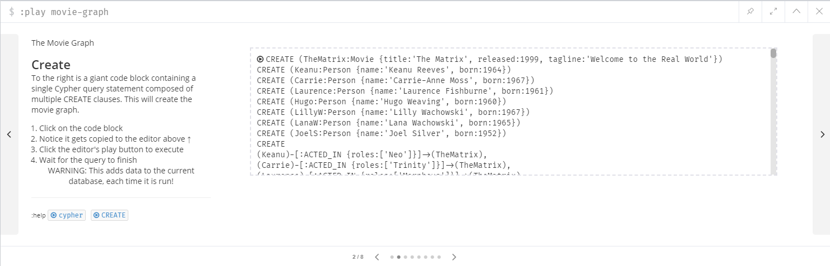
Loading the movie dataset

Slide 24
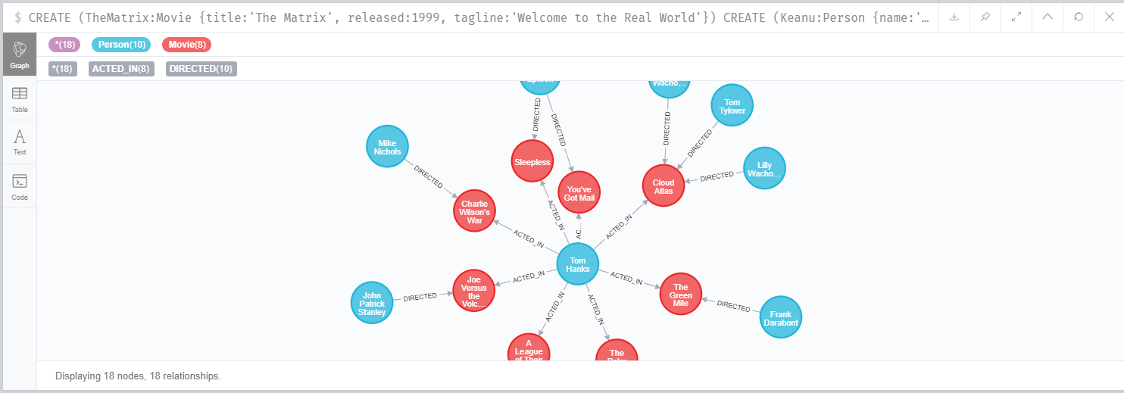
Results of data loading

Slide 25
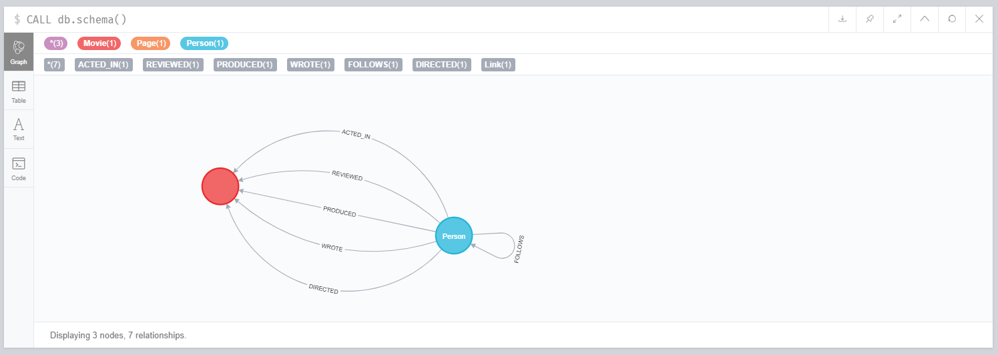
Show the DB Schema
From the menu Favorites>Common Procedures choose> show meta-graph.
Or directly run the query: CALL db.schema()

Slide 26
CREATE Nodes
This clause is used to create nodes, relationships, and properties.
Creating a Single node
CREATE (node_name)
Creating Multiple Nodes
CREATE (node1) , (node2)
Creating a Node with a Label
CREATE (node:label)
CREATE (Messi:player)
Creating a Node with Multiple Labels
CREATE (node:label_1:label_2:. . . . label_n)
CREATE (Messi:person:player)
Create Node with Properties
CREATE (node:label { key1: value, key2: value, . . . . . . . . . })
CREATE (Messi:player{name: "Lionel Messi", YOB: 1987, POB: "Rosario"})

Slide 27
CREATE Relationships
Creating Relationships
CREATE (node1)-[:RelationshipType]->(node2)
CREATE (Messi:player{name: "Lionel Messi", YOB: 1987, POB: "Rosario"})
CREATE (Arg:Country {name: "Argentina"})
CREATE (Messi)-[r:BORN_IN]->(Arg)
Creating a Relationship with Label and Properties
CREATE (node1)-[label:Rel_Type {key1:value1, key2:value2, . . . n}]-> (node2)
Creating a Complete Path
CREATE p = (Node1 {properties})-[:Relationship_Type]-> (Node2 {properties})[:Relationship_Type]->(Node3 {properties}) RETURN p

Slide 28
MATCH
The MATCH clause introduces the pattern we are looking for.
Node patterns can contain labels and properties.
MATCH (e:Employee) RETURN e.name, e.surname
Finding nodes by relationships
MATCH (e:Employee)-->(cc:CostCenter) RETURN *
* Returns all named nodes, relationships and identifiers

Slide 29
MERGE
MERGE command is a combination of CREATE command and MATCH command.
It searches for a given pattern in the graph. If it exists, then it returns the results.
If it does NOT exist in the graph, then it creates a new node/relationship and returns the results.
Syntax: MERGE (node: label {properties . . . . . . . })
MERGE (node:label) RETURN node
OnCreate and OnMatch
MERGE (node:label {properties . . . . . . . . . . .})
ON CREATE SET property.isCreated ="true"
ON MATCH SET property.isFound ="true"

Slide 30
Filtering properties
we can get all the employees that have a relation with a specific cost center, for example CC1.
Properties are expressed within curly brackets.
MATCH (e:Employee) --> (:CostCenter {code: 'CC1' }) RETURN e
Here, as you can notice, we omitted the cc variable (we don’t need it!).

Slide 31
Matching by the Relationship
Relationship expressions must be specified in square brackets.
To filter the employees who belong to a specific cost center, we have to specify the relationship type:
MATCH (n) -[:BELONGS_TO]-> (:CostCenter { code: 'CC1' } ) RETURN n

Slide 32
OPTIONAL MATCH
Search for the pattern described in it, while using nulls for missing parts of the pattern.
OPTIONAL MATCH is similar to the match clause, the only difference being it returns null as a result of the missing parts of the pattern.
MATCH (a:Movie { title: 'Cloud Atlas' })
OPTIONAL MATCH (a)-->(x)
RETURN x
Returns null, since the node has no outgoing relationships.

Slide 33
WHERE
Use a predicate to filter. Note that WHERE is always part of a MATCH, OPTIONAL MATCH or WITH clause.
Putting it after a different clause in a query will alter what it does.
WHERE n.property <> $value
MATCH (e:Employee) --> (cc:CostCenter)
WHERE cc.code='CC1‘
RETURN e

Slide 34
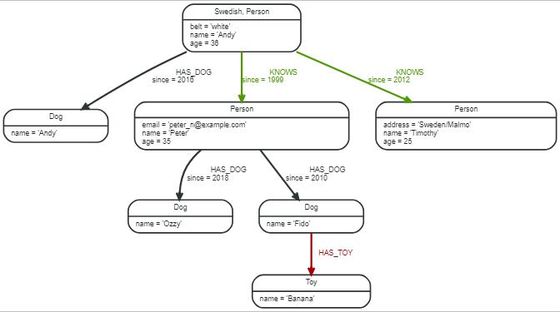
WHERE
Filter on node label
Filter on a relationship property
Match(n)
WHERE n:Swedish
RETURN n.name, n.age
MATCH (n:Person)-[k:KNOWS]->(f)
WHERE k.since < 2000
RETURN f.name, f.age, f.email

Slide 35
DISTINCT (Unique results)
DISTINCT retrieves only unique rows depending on the columns that have been selected to output.
RETURN distinct expr
Example:
MATCH (a { name: 'A' })-->(b)
RETURN DISTINCT b
The node named "B" is returned by the query, but only once.

Slide 36

Paging results – LIMIT and SKIP
Paging is necessary to avoid a lot of data from being loaded all together in a single query.
MATCH (b:Book)
WHERE b.title =~ '(?i).*drama.*' RETURN b
LIMIT 20
MATCH (b:Book) WHERE b.title =~ '(?i).*drama.*‘
RETURN b SKIP 20 LIMIT 20

Slide 37
Sorting (Order By)
Sorting with Cypher is exactly the same as sorting with SQL using (ORDER BY).
MATCH (b:Book) RETURN b.title ORDER BY b.title LIMIT 5
A descending sort: By default sort is ascending, you can reverse the order using DESC clause.
MATCH (b:Book) RETURN b.title ORDER BY b.title DESC

Slide 38
COUNT
count(*), counts the number of matching rows.
count(variable), counts the number of non-null values.
count(DISTINCT variable), count can take the DISTINCT operator, which removes duplicates from the values.
MATCH (b) <-[r:Vote]- (u:User)
RETURN COUNT(*) as votes

Slide 39
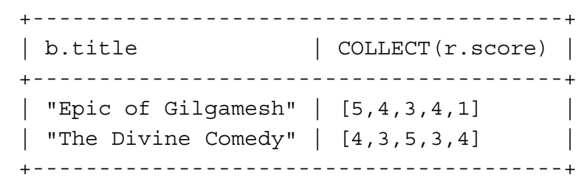
Collecting values in an array
You can collect all the values in an array so that you can easily process them with your preferred algorithm.
For example, the following query returns all the score votes received for books:
MATCH (b:Book) <-[r:Votes]- (:User) RETURN b.title, COLLECT(r.score)

Slide 40
WITH (Separating query parts)
The WITH syntax is similar to RETURN.
It separates query parts explicitly, allowing you to declare which variables to carry over to the next part.
One common usage of WITH is to limit the number of entries that are then passed on to other MATCH clauses.
MATCH (user)-[:FRIEND]-(friend)
WHERE user.name = $name
WITH user, count(friend) AS friends
WHERE friends > 10
RETURN user

Slide 41
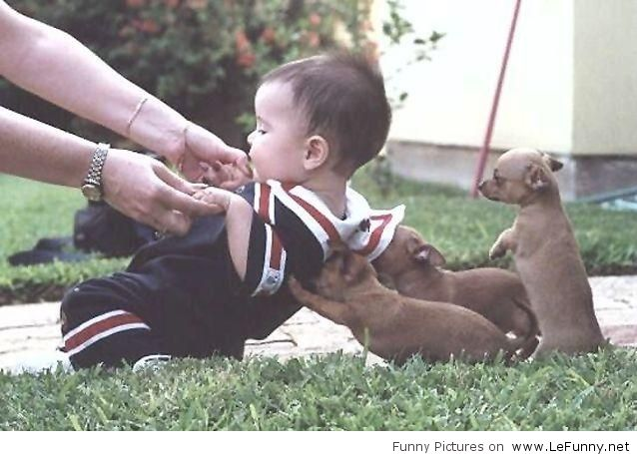
Cypher Docs. & Cheat Sheet
https://neo4j.com/docs/cypher-manual/3.5/introduction/
https://neo4j.com/docs/cypher-refcard/current/
https://neo4j.com/docs/cypher-manual/current/

Slide 42

Now, It’s time to say ...

